Slide 1

EpiMC: Predicting And Detecting Epistatic Interactions Using
Multiple Clusterings
Medimi Gagana Sree(1SJ23AD028)
K Chandra Priya(1SJ23AD021)
S Bhavya Sree(1SJ23AD051)
Pallavi B Gowda(1SJ23AD035)
Under the guidance of
Mr. Badrinath K
Assistant Professor, Dept of AI&DS,SJCIT

Slide 2
PROBLEM STATEMENT
Detecting gene–gene (epistatic) interactions from SNP data is important for understanding complex diseases, but it is challenging due to high-dimensional data and large computational complexity. Existing methods are either slow or miss important interactions. Therefore, this project proposes an efficient AI-based multiple clustering approach to reduce the search space and improve accuracy in detecting significant gene interactions.

Slide 3
ABSTRACT
Detecting gene interactions (epistasis) is important for understanding complex diseases like cancer and diabetes . Traditional methods focus on single genes and often miss important interactions. This project proposes EpiMC, a method to efficiently detect SNP interactions. It uses multiple clustering techniques to group genetic data from different perspectives.

Slide 4
INTRODUCTION
Genome-wide association studies help scientists understand how small changes in genes, called SNPs, are linked to complex diseases like cancer or diabetes, but traditional methods usually look at each gene separately and miss how genes interact with each other. This project introduces a method called EpiMC, which focuses on finding these gene interactions (epistasis) more effectively by grouping SNPs in multiple ways and then analyzing them together. By using different clustering techniques and reducing unnecessary data, the method makes it easier and faster to identify important gene combinations related to diseases, leading to better understanding of genetic causes and improving disease research.

Slide 5
LITERATURE SURVEY
SL.NO | Author | TITLE | ADVANTAGES | DISADVANTAGES | IMPLEMENTATION
1 | Lotfi Slim et al. (2020) | Novel methods for epistasis detection in genome‑wide association studies | Proposes a new method (epiGWAS) that identifies SNP interaction partners across genome. | May still suffer from high multiple testing burden and computational expense on full GWAS. | epiGWAS: targets SNP × genome interactions using novel statistical formulation.
2 | Qiushi Zhang et al. (2024) | Genome‑wide epistasis analysis reveals gene–gene interaction network on P‑tau/Aβ42 ratio | Large number of SNP‑SNP pairs (961) detected; uses quantitative trait to boost signal; replicates known genes. | Requires heavy computing (GPU) for exhaustive interaction scan. | Genome‑wide SNP × SNP scan with linear regression and multi‑GPU parallel computing.
3 | Boyang Fu et al. (2025) | A biobank‑scale test of marginal epistasis reveals genome‑wide signals. | Highly scalable on biobank‑scale (≈300K); can handle many traits; reduces multiple testing burden by testing. | Assumes interaction effects are independent of main effects. | FAME (Fast Marginal Epistasis test): variance component model.

Slide 6
SL.NO | Author | TITLE | ADVANTAGES | DISADVANTAGES | IMPLEMENTATION
4 | Wenlong Ren & Zhikai Liang (2024 | Review on GPU accelerated methods for genome‑wide SNP‑SNP interactions | Survey of recent GPU‑based tools; shows GPU gives major speedups over CPU methods. | Need continuous hardware optimization; algorithmic improvements still required. | GPU parallel computing acceleration for exhaustive epistasis detection.
5 | Marleen Balvert et al. (2024) | Considerations in the search for epistasis (review) | Identifies key challenges and best practices; helps researchers plan better studies. | Not a new detection method; mostly conceptual review. | Discusses protocols, pitfalls, and future directions in epistasis detection.
6 | Fu et al. (2025) | Biobank-scale marginal epistasis testing | Works on very large datasets; reduces multiple testing problem | May miss local interactions; assumes certain statistical conditions | FAME method (variance component model)

Slide 7
DISADVANTAGES IN EXISTING STYSTEM
Lack of biological relevance
Clustering groups SNPs based on statistical similarity, not actual gene interactions, so results may not reflect true biological relationships.
Increased computational complexity
Running multiple clustering algorithms and combining their results adds time and resource overhead without guaranteed improvement.
Misses higher-order interactions
The approach mainly focuses on pairwise interactions and may fail to capture complex interactions involving three or more genes.
Risk of losing important SNPs
Filtering during clustering can eliminate rare or weak-effect SNPs that might actually be biologically significant.

Slide 8
PROPOSED SYSTEM
Develop a system that uses multiple clustering techniques to group SNPs effectively
Incorporate cluster stability analysis to ensure reliable SNP groupings
Apply feature selection methods to identify significant SNPs
Implement an optimized approach to detect epistatic interactions between SNPs
Compare performance with existing methods like EpiMC: Detecting Epistatic Interactions Using Multiple Clusterings

Slide 9
METHODOLOGY
Collect and preprocess SNP dataset with phenotype information
Apply multiple clustering techniques to group SNPs
Perform consensus and stability analysis on clusters
Select significant SNPs using feature selection methods
Generate candidate SNP pairs from selected clusters
Detect epistatic interactions and evaluate performance against baseline methods

Slide 10
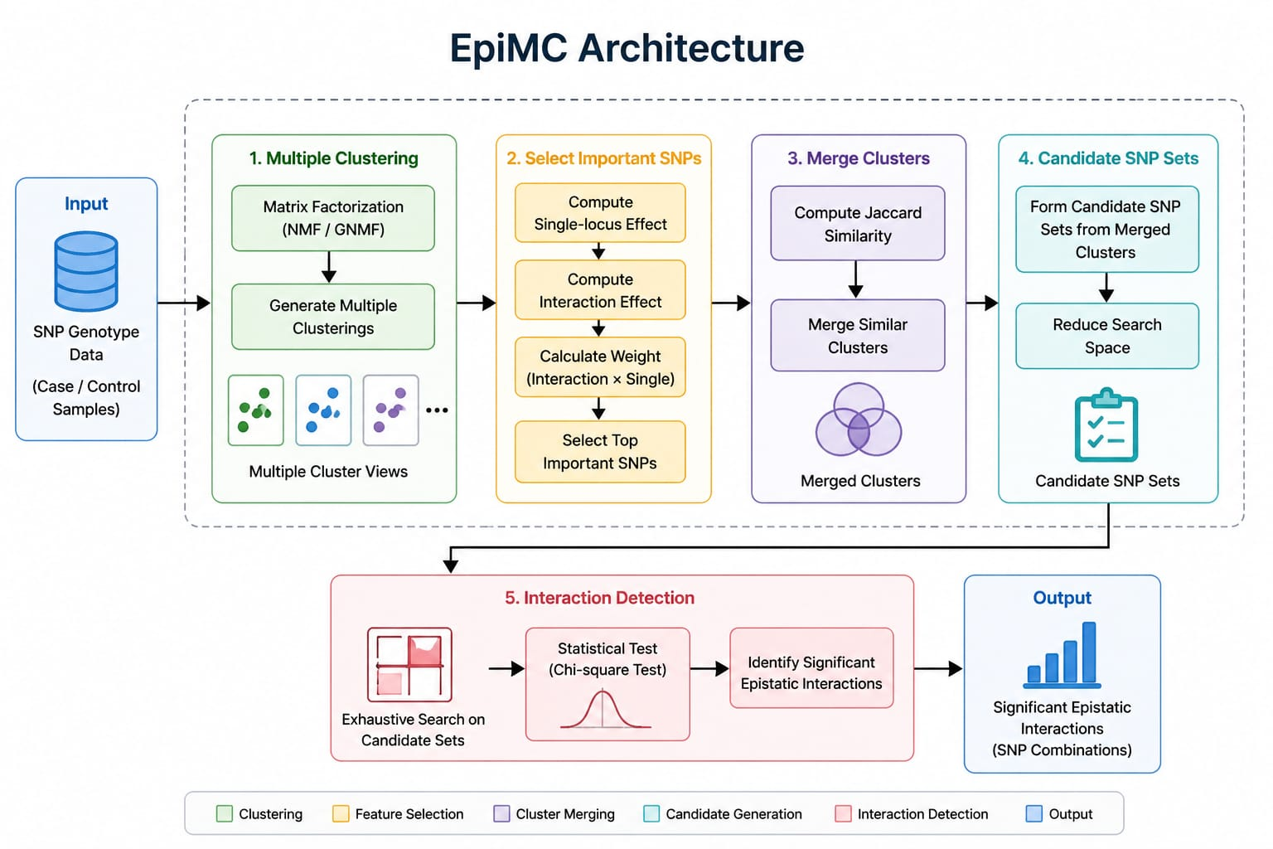
DESIGN

Slide 11
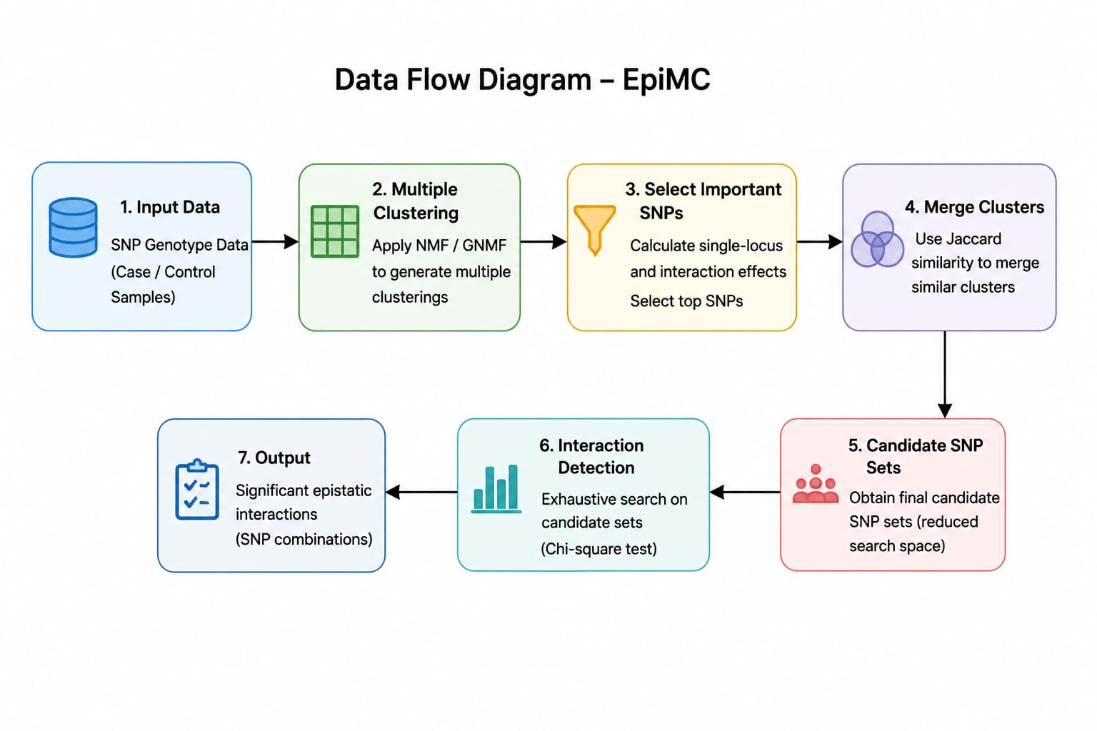
DATA FLOW DIAGRAM

Slide 12
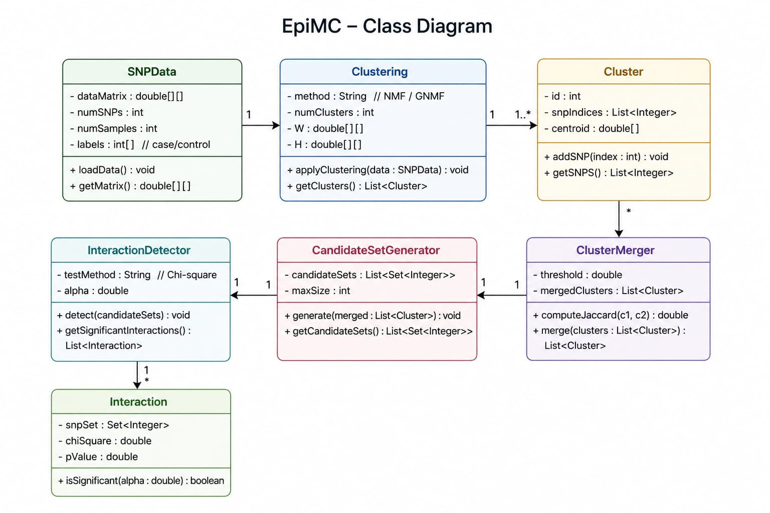
CLASS DIAGRAM

Slide 13
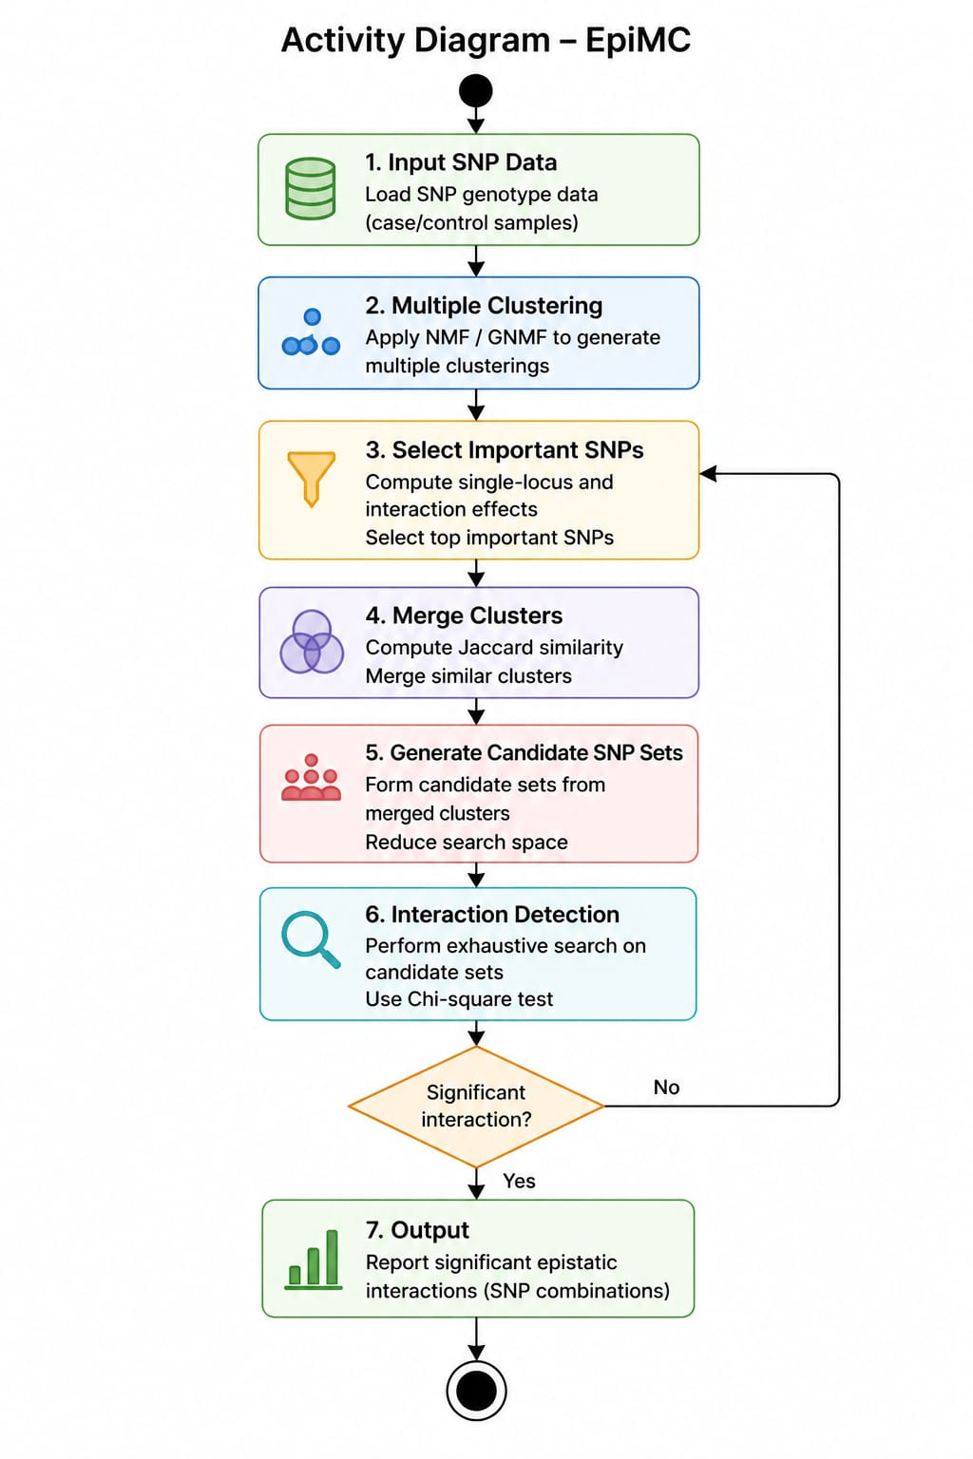
ACTIVITY DIAGRAM

Slide 14
PROPOSED OUTCOMES
Identification of significant epistatic SNP interactions associated with the target disease
Reduced search space compared to traditional exhaustive methods
Improved performance (Accuracy, AUC) over baseline approaches
Generation of a ranked list of high-impact SNP pairs
Comparative results demonstrating advantage over methods like EpiMC: Detecting Epistatic Interactions Using Multiple Clusterings
A complete working system with implementation, analysis, and validated results

Slide 15
PROJECT PLAN 2.0
Design
Define problem and design system architecture
Select algorithms (clustering, SNP selection, interaction detection)
Implementation
Collect and preprocess SNP data
Implement clustering, SNP selection, and merging modules
Testing
Test each module individually
Evaluate accuracy and performance using datasets
Finalization
Analyze results and optimize system
Prepare report, PPT, and final submission

Slide 16
THANK YOU

